Slide 1
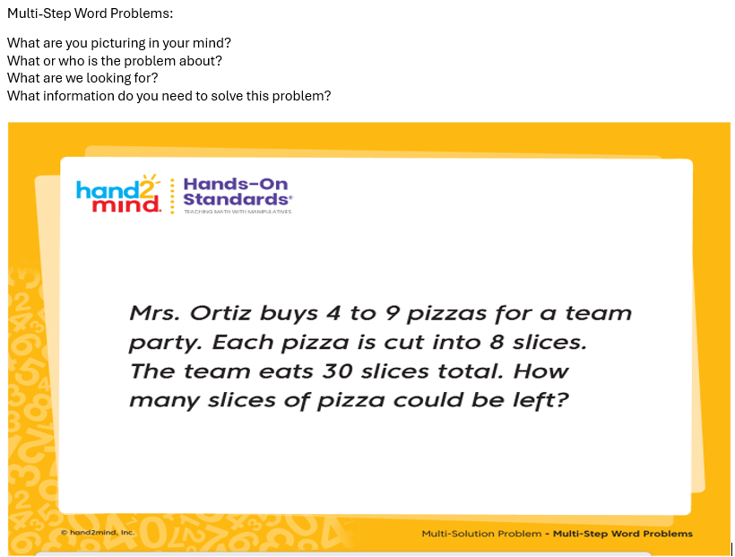
Week 12: POD: Day 1

Slide 2
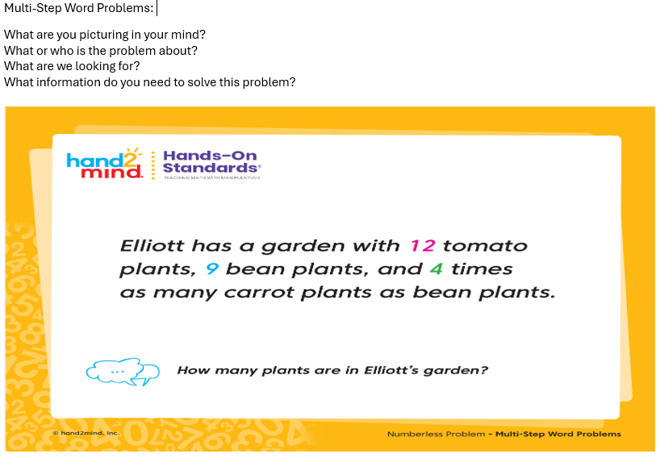
Week 12: POD: Day 2

Slide 3
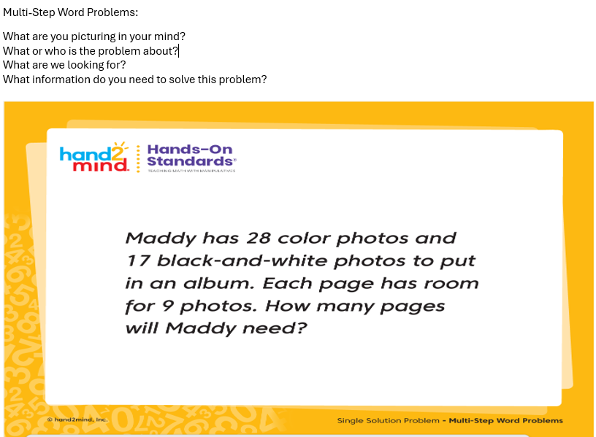
Week 12: POD: Day 3

Slide 4
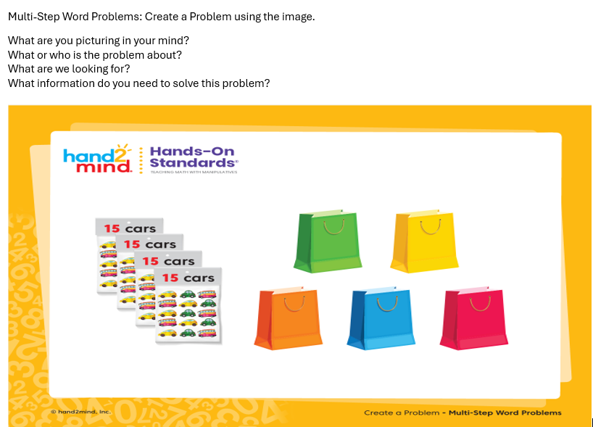
Week 12: POD: Day 4

Slide 5
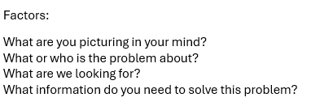
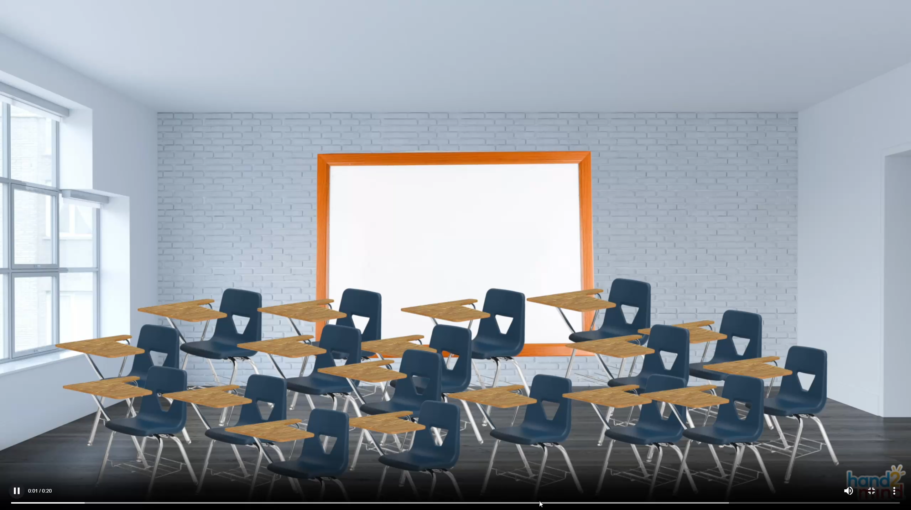
Week 12: POD: Day 5
Video Problem

